Slide 1
<Today’s Goal>
理由をたずねたり答えたりしよう。

Slide 2
Her name is
Chihiro.

Slide 3
Why does
she study
English
very hard?

Slide 4
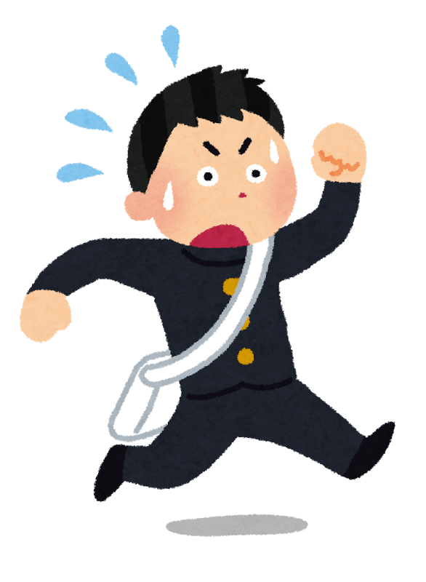
His name is
Yusuke.

Slide 5
Why does
he hurry?

Slide 6
<Today’s Point>
Why does he hurry?
「なぜ」

Slide 7
<Today’s Point>
Why does he hurry?
「なぜ」
He is late for school.

Slide 8
<Today’s Point>
Why does he hurry?
「なぜ」
Because he is late
for school.
「～だから」

