Slide 1
speaks
talks

Slide 2
sings

Slide 3
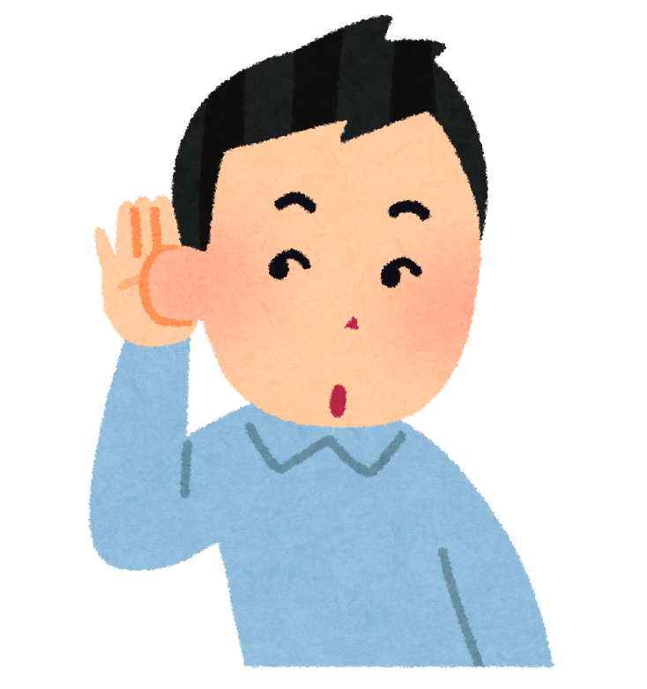
listens

Slide 4
reads

Slide 5
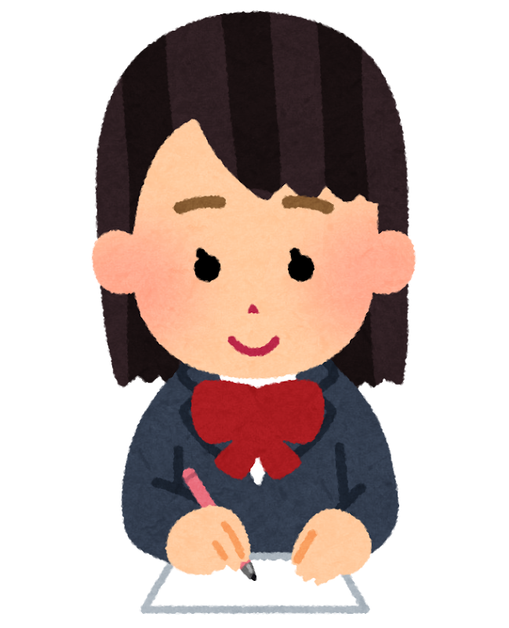
writes

Slide 6
eats

Slide 7
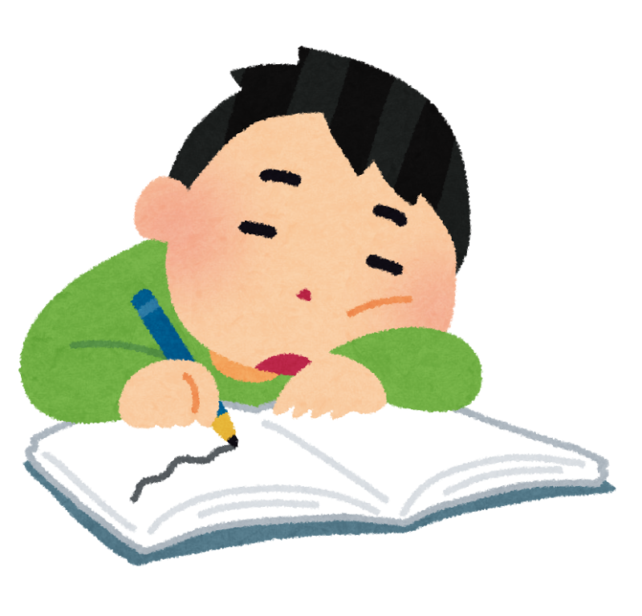
sleeps

Slide 8
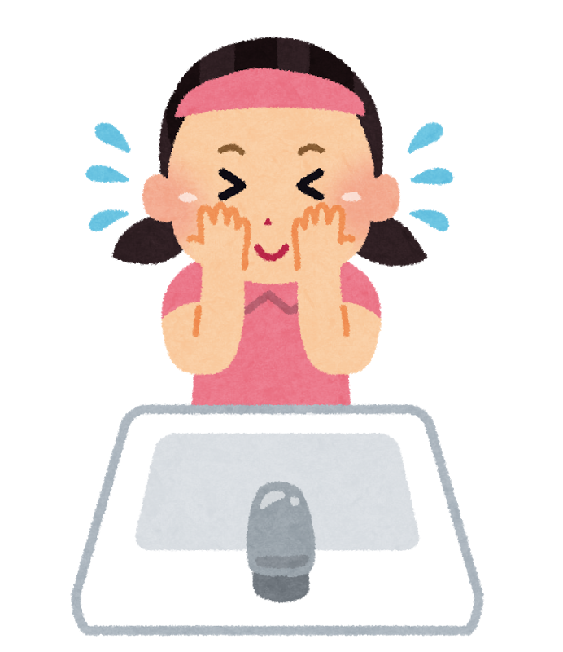
washes

Slide 9
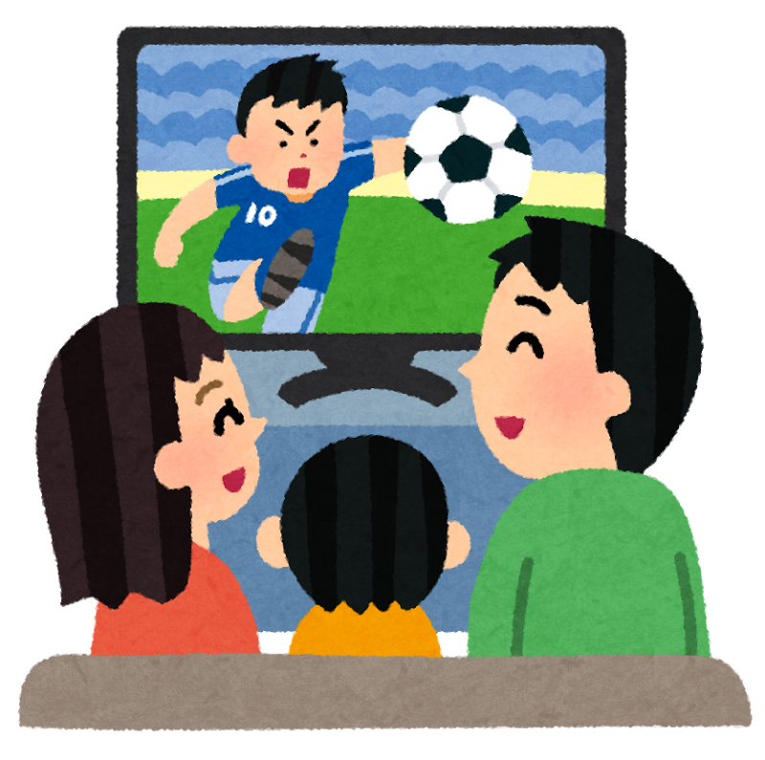
watches

Slide 10
cooks

Slide 11
uses

Slide 12
studies

